Slide 1

Weekly Meeting
June 19, 2023

Slide 2
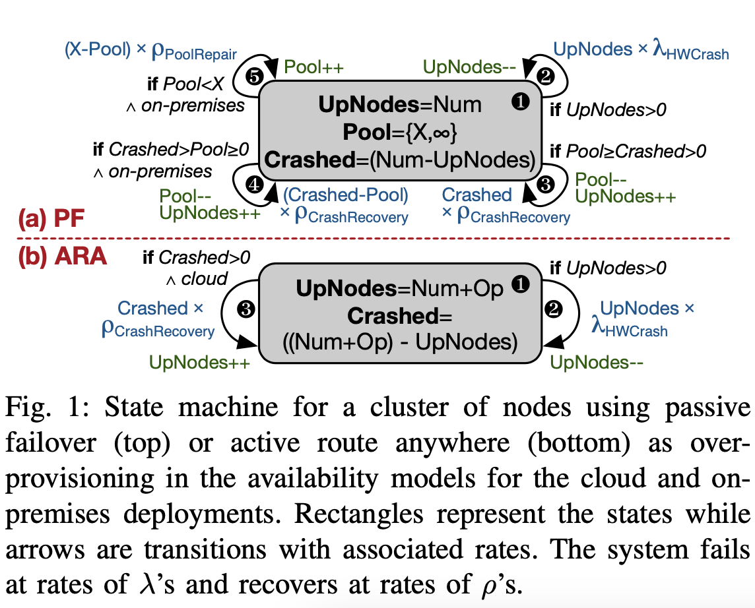
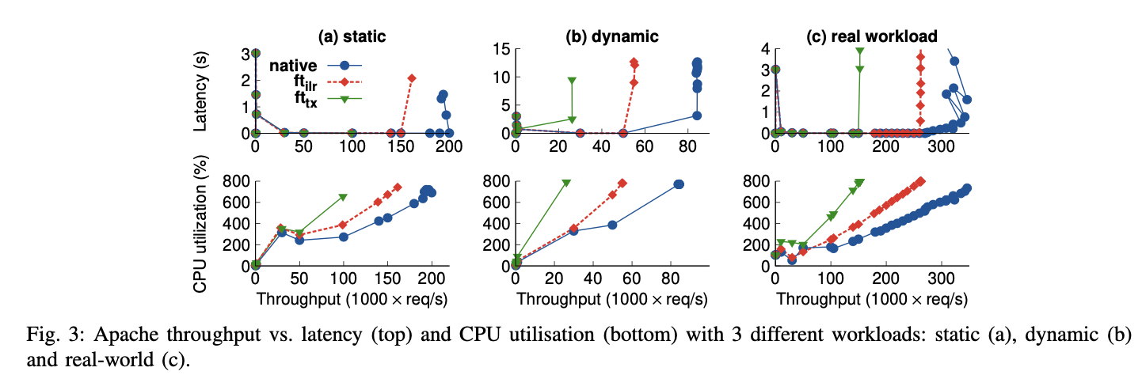
Paper #1: PCRAFT: Capacity Planning for Dependable Stateless Services
a system to enable capacity planning of dependable services.
to quantify the number of nodes needed to ensure the dependability of stateless services
traditional service-level availability mechanisms (active route anywhere and passive failover) + deployment schemes (cloud and on-premises) = quantify the number of nodes needed to satisfy the given availability and performance constraints.
Showed: passive failover requires fewer nodes than active route anywhere.
Passive failover: standby system that remains idle and inactive until the primary system fails.
ARA: When a failure occurs, requests are automatically routed to other available servers, and clients can continue to access the system without interruption.
Approaches for handling system failures in a high availability setting:
Fault tolerance mechanisms:
Native: provides fault tolerance by creating a mirrored instance of a virtual machine on a different physical host.
Ft_ilr: if a fault occurs on the primary machine, the secondary machine can seamlessly take over without losing any data
Ft_tx: a hardware-based approach that uses specialized hardware to replicate the execution of a virtual machine on multiple physical hosts

Slide 3
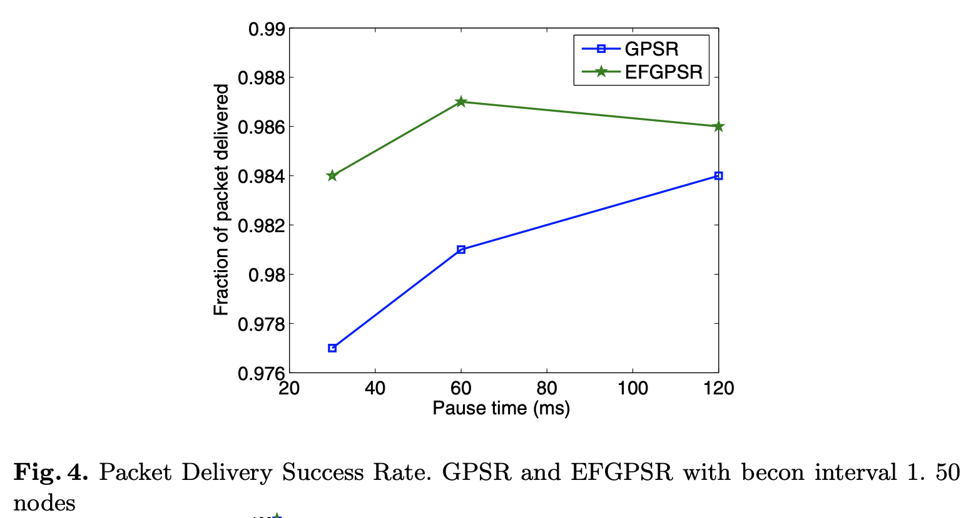
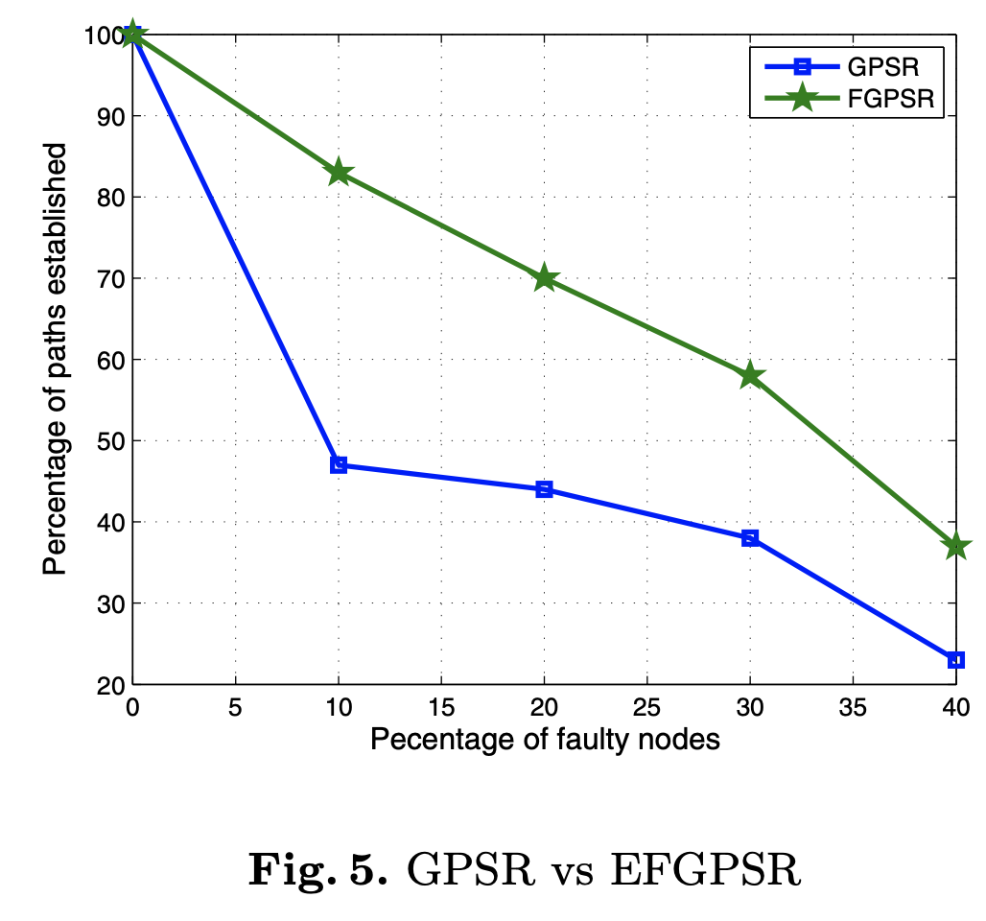
Paper #2: Energy Efficient and Fault Tolerant GPSR in Ad Hoc Wireless Network
Establish path between source and destination node pairs
1. Fault testing Phase: all nodes come to know about their fault free neighbors
2. Planarization Phase
3. EE greedy forwarding Phase: minimum distance + energy = minimum cost option
4. EE perimeter forwarding Phase
try to maintain balance between the metrics to choose the next hop and selection of node having highest energy among the neighboring node to extend network lifetime
Res: EFGPSR provides higher no. of path between source and destination out of the total no. of paths (i.e., 20) than GPSR
increasing the network lifetime, successful packet delivery ratio with insignificant increase in number of hop count.

Slide 4
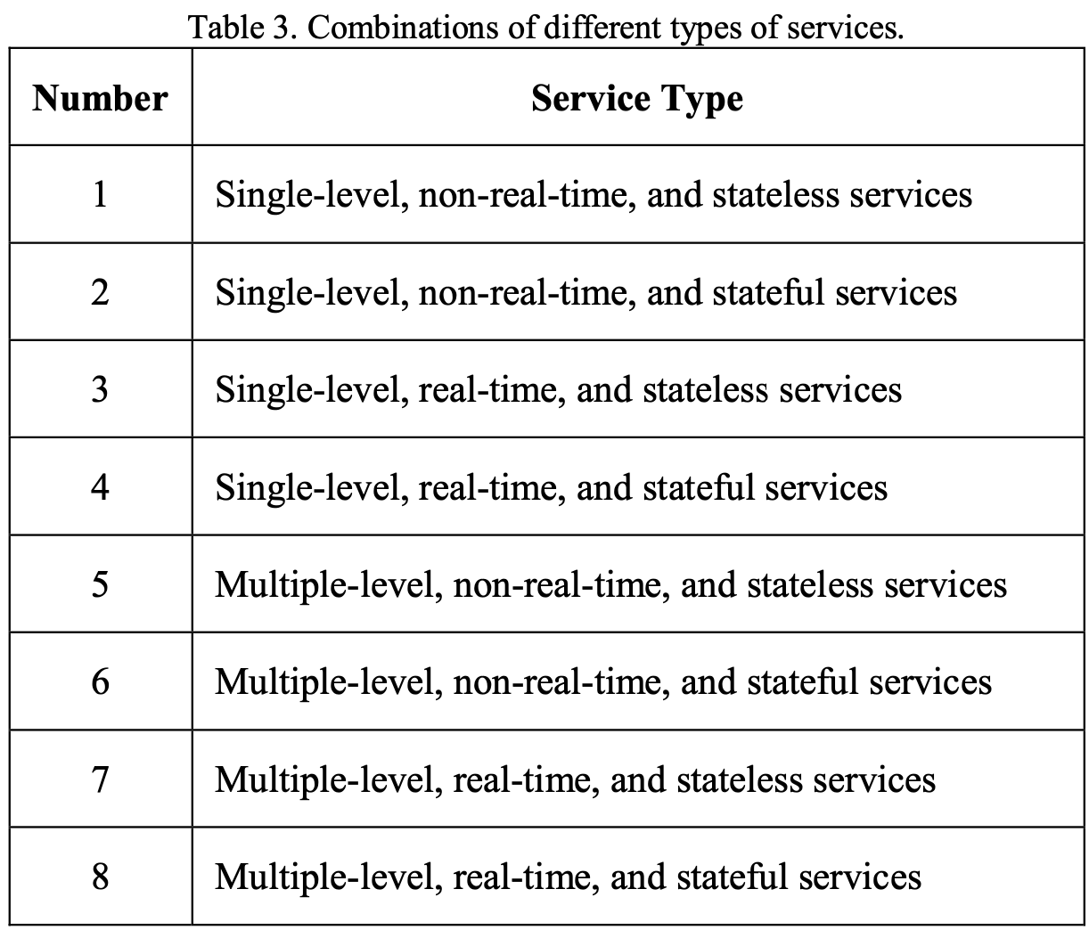
Paper #3: Towards Fault Tolerant Fog Computing for IoT-Based Smart City Applications
It investigates different considerations to achieve a good degree of fault-tolerance for fog computing supporting smart city applications.
it is important to first discuss the different types of services to leverage the understanding of different possible fault-tolerance issues and mechanisms for these types.
To achieve this, we need to identify the different types of services: stateless vs. stateful; real-time vs. delay-tolerant; and single level vs. multiple level.

Slide 5
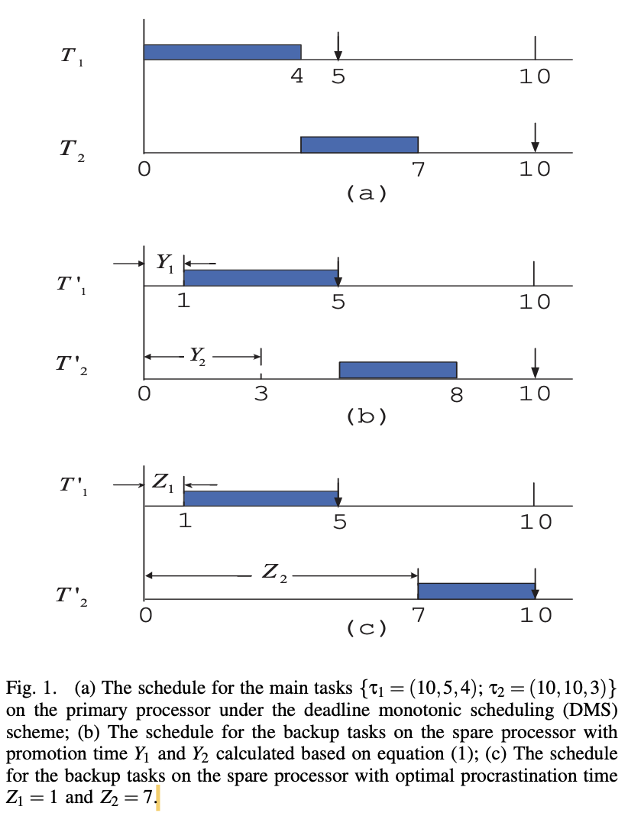
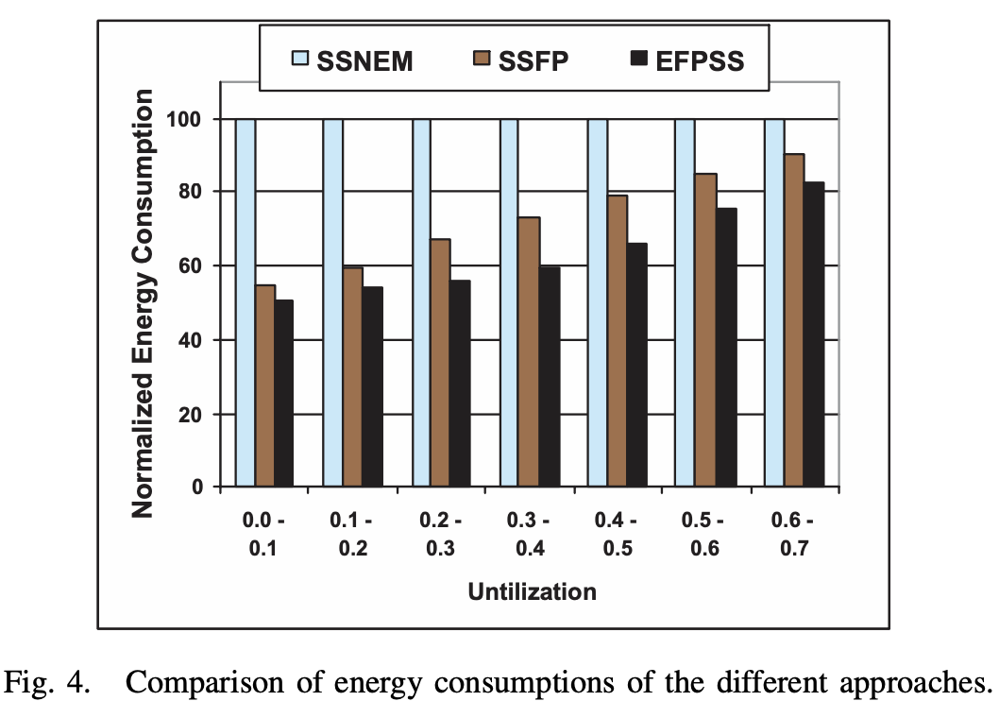
Paper #4: Work-In-Progress: Enhanced Energy-Aware Standby-Sparing Techniques for Fixed-Priority Hard Real-Time Systems
The standby-sparing system adopts a primary processor and a spare processor to provide fault tolerance for both permanent and transient faults.
enhanced fixed-priority scheduling schemes to minimize the overlapped concurrent executions of the workloads, enabling energy savings
For each real-time job executed on the primary processor, there is a corresponding backup job reserved for it on the spare processor
possible to procrastinate the backup job(s) further to enable better energy savings.
tasks allocated on processors in a hybrid way, there are opportunities to delay the backup jobs further to boost energy savings.
the maximal energy reduction by EFPSS can be around 18%.

Slide 6
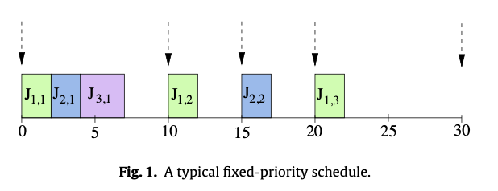
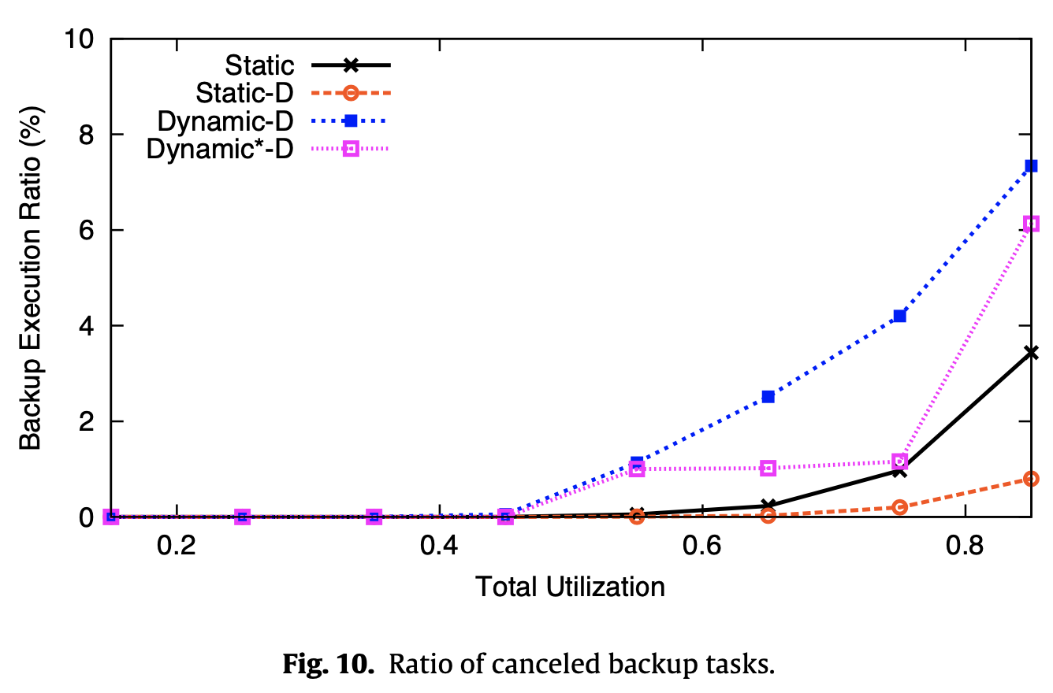
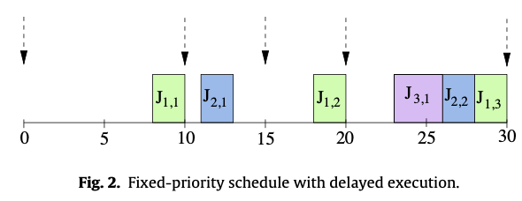
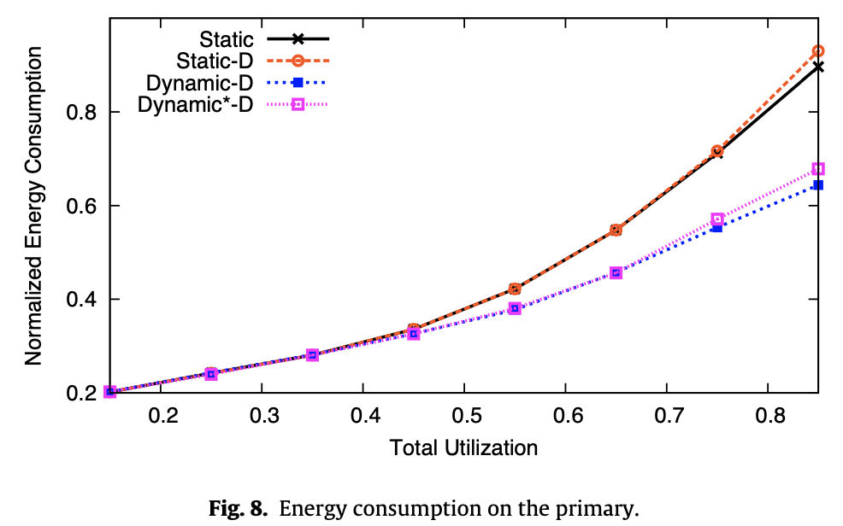
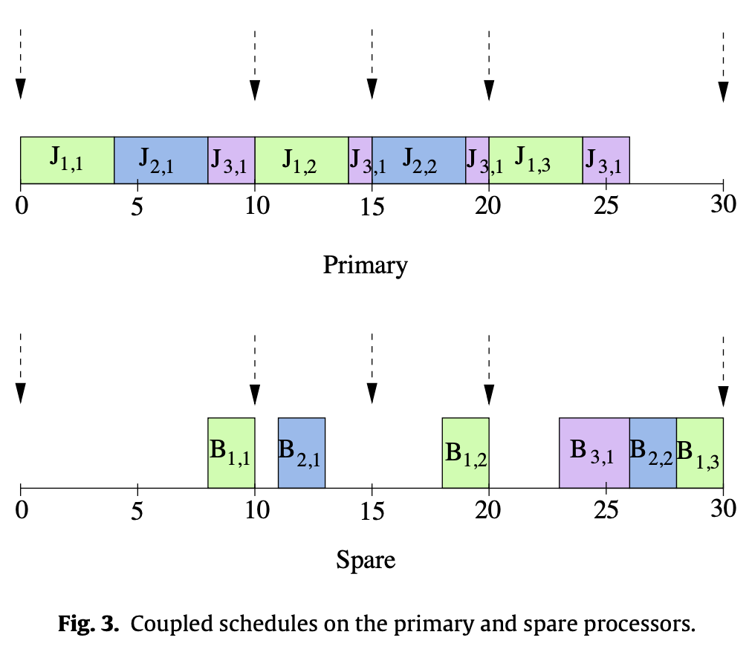
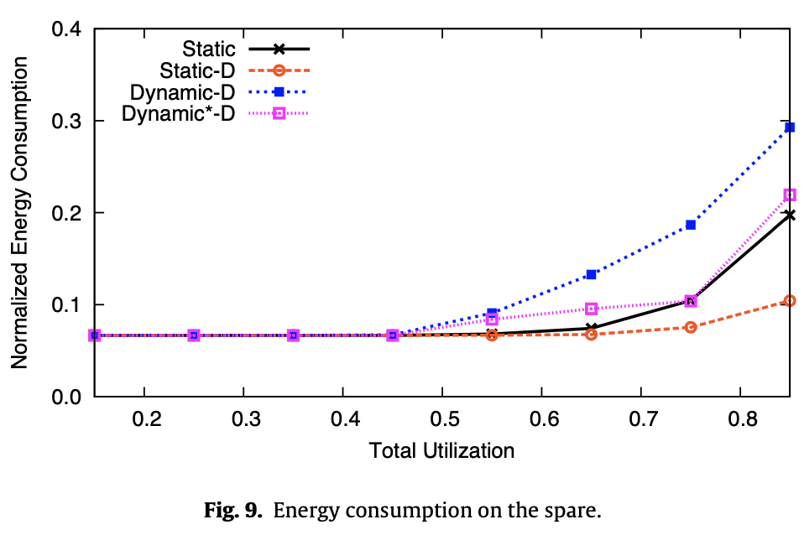
Paper #5: Energy-aware standby-sparing for fixed-priority real-time task sets
proposes a dual-queue mechanism to delay the execution of backup tasks and minimize overlap with main tasks.
Tested static vs dynamic delaying methods
our solution is seen to save more energy at medium to high load values despite deploying the additional spare processor, while offering clear advantages in terms of reliability.
Results: The experimental evaluation shows that the proposed schemes effectively reduce energy consumption while maintaining system reliability
Improved Reliability: The study demonstrates that the standby-sparing scheme provides fault tolerance by executing backup tasks on a spare processor
Energy Efficiency: The dual-queue mechanism maximizes the delay of backup tasks, allowing for the cancellation of unnecessary backup executions and reducing energy consumption in the system.

Slide 7
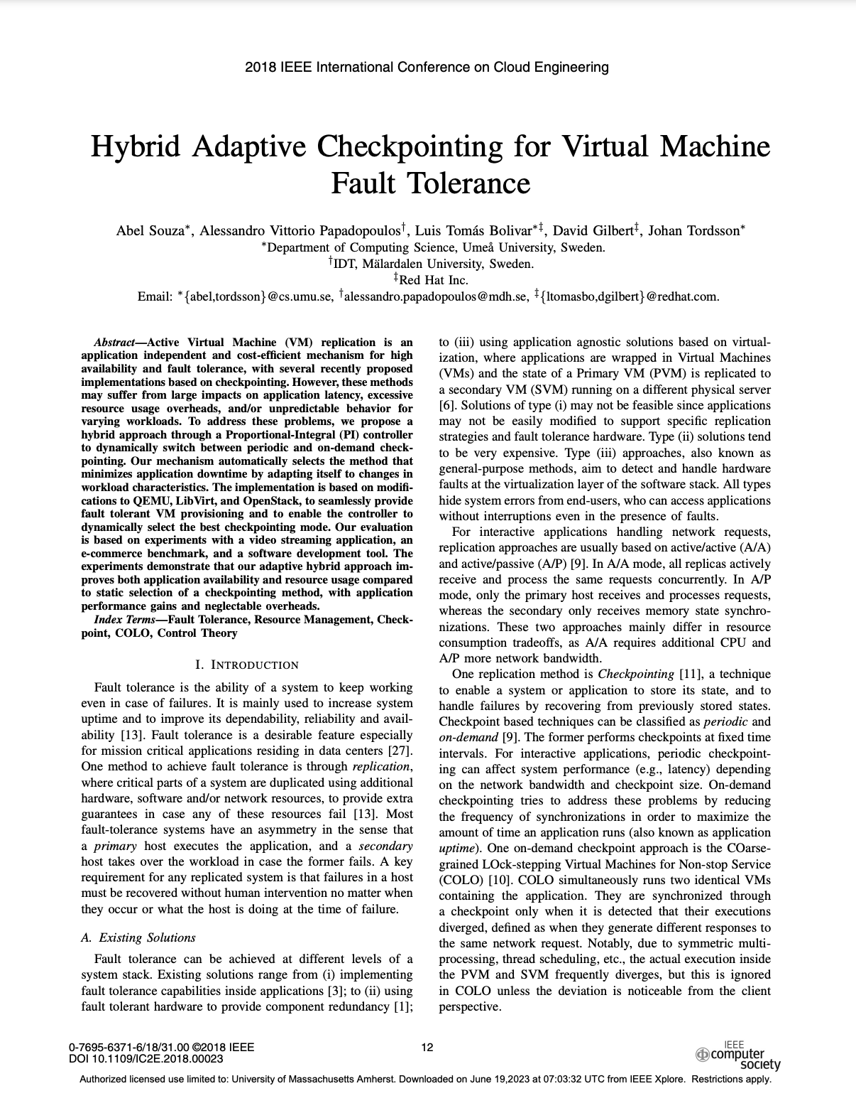
A possible paper?
.

